Slide 1
Effective AHI: the New PARADIGM for Evaluation of Treatment
NJ Sleep Society
November 14, 2020
Edward T Sall MD DDS MBA

Slide 2
Disclosures:
Medical Director: ProSomnus Sleep Technologies
Medical Director of Dental Sleep Medicine at BetterNight

Slide 3
Responsibilities of the Chief Medical Officer
Review of the literature in medicine and dentistry in the field of OSA.
Participating and initiating new research studies regarding the efficacy of oral appliance therapy in the treatment of OSA
Developing, organizing, and participating in continuing education conferences, symposiums, and industry sponsored events in response to requests by management for these services.
Acting as a liaison to the medical specialties to promote the utilization and growth in acceptance of oral appliance therapy in the treatment of OSA.
Functioning as an Ambassador for ProSomnus to represent the company’s constant innovation and quality initiatives and grow the field of oral appliance therapy in a competitive and rapidly evolving business environment.

Slide 4
Why not CPAP?
Introduced as the “gold” standard in the treatment of OSA in 1981.
Compliance is defined by Medicare as 4-5 hours of usage 7 out of 10 nights.
Efficacy is over 95% when used on a nightly basis.
Machines are lighter, quieter, more portable and easier to clean than in the past.

Slide 5
Why not CPAP?
May be titrated in the lab or in the home via APAP.
Widely covered by many and most medical insurance carriers including Medicare.
Compliance may be monitored by downloading usage data via chips in the machine.
Usage and pressure change recommendations can now be monitored via Telemedicine.

Slide 6
Why not CPAP?
Lab titrations and in home AutoPAP titrations give a high level of confidence of the efficacy of CPAP in the treatment of OSA.
Pulmonologists and Sleep Physicians prefer CPAP due to the high level of efficacy in the treatment of OSA.
Numerous DME providers are available to dispense CPAP, supplies, and mask changes as necessary.

Slide 7
CPAP: The Gold Standard!
Efficacy is 90-95% but compliance is < 40%.
Compliance has not improved with smaller and quieter machines.
Traveling with CPAP (especially in airports) has become burdensome.
Ability to have electricity may be limited with deployment.
Nasal congestion and URI limit the use of CPAP.
Many DME companies provide poor care and patients struggle to get supplies in a timely fashion.

Slide 8
Gold or “Gold Plated”
The gold standard works 40% of the time or less!
Patients hate CPAP!
Even the 40% or less that tolerate CPAP often struggle to wear it all night long!
Why isn’t compliance 7-8 hours per night for every night?

Slide 9
Contraindications for CPAP
Uncooperative or extremely anxious patient
Reduced consciousness and inability to protect airway
Unstable cardiorespiratory status or respiratory arrest
Trauma or burns involving the face
Facial, esophageal, or gastric surgery

Slide 10
Contraindications for CPAP
Air leak syndrome (pneumothorax with bronchopleural fistula)
Copious respiratory secretions
Severe nausea with vomiting
Severe air trapping diseases with hypercarbia asthma or chronic obstructive pulmonary disease (COPD)

Slide 11
CPAP Adherence Data
30% of patients fail to initiate therapy after diagnosis.
Of those starting therapy, 25% stop within the first year.
Less than 40% remain adherent in the long term.
Among those that use CPAP regularly, average nighttime use is 3.5 to 5.3 hours!

Slide 12
Quantifying Adherence with PAP Treatment
Insurance criteria for “adherent” equates to the use of PAP > 4 hours/night for at least 70% of the nights.
A patient only has to use CPAP 86 hours per month, or 35% of the total recommended sleep time, to be considered adherent.
PAP adherence reports reveal the amount of time the PAP device was in use.
PAP Adherence data does not include the time awake , nor do they record sleep without PAP.

Slide 13
Quantifying Adherence with PAP Treatment
Compliance reports do not differentiate between patients who only intermittently use PAP, those who use it every night but only for part of the night or those who use PAP during every sleep period but are grossly sleep restricted.
Commonly reported objective measures represent an upper bound estimate of how long PAP was worn during sleep, which is frequently an inaccurate reflection of both total sleep time and true adherence.

Slide 14
Quantifying Adherence with PAP Treatment
The persistence of symptoms may reflect insufficient sleep, insufficient use of PAP, limitations in the efficacy of PAP or some combination of each.
Despite their objective nature, PAP use reports do not answer this question.
Clinical assessment and results of outcomes research should be interpreted with this limitation in mind.

Slide 15
Efficacy of PAP Therapy
Increased use leads to greater improvements in outcomes.
Therapy is efficacious , but its effectiveness is limited by insufficient use.
Multiple studies have reported a dose-response relationship between hours of PAP use and improvements in OSA severity, neurocognitive performance, symptoms, and mortality.
The low threshold defining PAP adherence is a result of conflicting studies on outcomes with respect to the number of hours of use.

Slide 16
Outcomes vs Hours of PAP Therapy
Weaver et al (2007)
Depending on the outcome, different durations of nightly PAP use were required to show improvement.
Subjective alertness improved after 4 hours of use.
Objective improvements in MSLT required at least 6 hours of use.
Functional outcomes required at least 7 hours of PAP use per night for optimization.

Slide 17
Factors that Affect Adherence to PAP
Patient’s understanding of the underlying disorder and therapeutic strategy.
Perceived benefit of treatment.
Initial experiences with an intervention.
Overall health behaviors.

Slide 18
Factors That Affect Adherence to PAP
Age, gender, ethnicity, socioeconomic status, and education level have been shown to influence PAP adherence but, with variable results.
The impact of disease-specific features , such as OSA severity, degree of symptoms, and the presence of medical comorbidities are similarity inconsistent.
Increased nasal resistance and claustrophobia are clearly associated with increased difficulty in adapting to PAP.

Slide 19
Factors the Affect Adherence to PAP
Perceived benefit of, and the subjective response to therapy represent the most robust determinants of PAP adherence.
Adherence requires that the patient perceive this treatment as beneficial, be motivated to initiate therapy, and have a sense of self- efficacy regarding the use of PAP successfully.
Patients who lack a sense of motivation or perceived benefit, or those who endorse negative perceptions regarding inconvenience or discomfort with PAP, are not likely to use therapy.

Slide 20
Factors that Affect Adherence to PAP
A patient’s understanding of OSA and benefits of PAP will not improve adherence in isolation.
The response to therapy greatly influences the patient’s continued use of PAP.
Although baseline symptoms have been shown to predict subsequent PAP use, adherence is significantly higher among those who experience greater reductions of these symptoms.
Those who have more comfort and a better initial experience with PAP are more likely to continue use, early experiences predict long-term use.

Slide 21
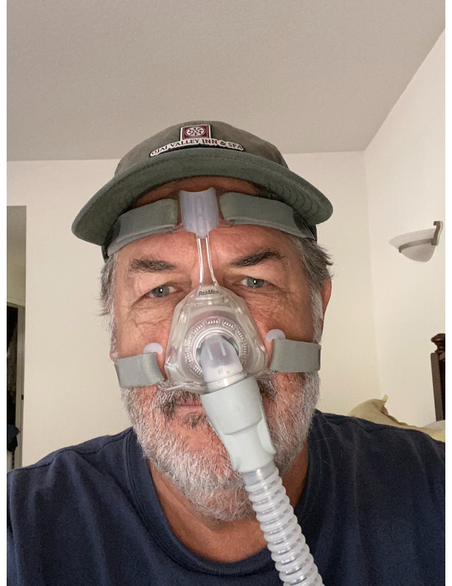
Gold or “Gold Plated” Standard?

Slide 22
CPAP: the Gold “Plated” Standard
Its time to change the so called label as the standard of care in the treatment of OSA.
OAT is not a new treatment for OSA.
The AASM guidelines recommend Oral Appliances in the treatment of patients with mild to moderate OSA as first line therapy in patients that prefer this treatment over CPAP.
Patients with severe OSA should have a trial of CPAP before treatment with OA’s (AASM guidelines).

Slide 23
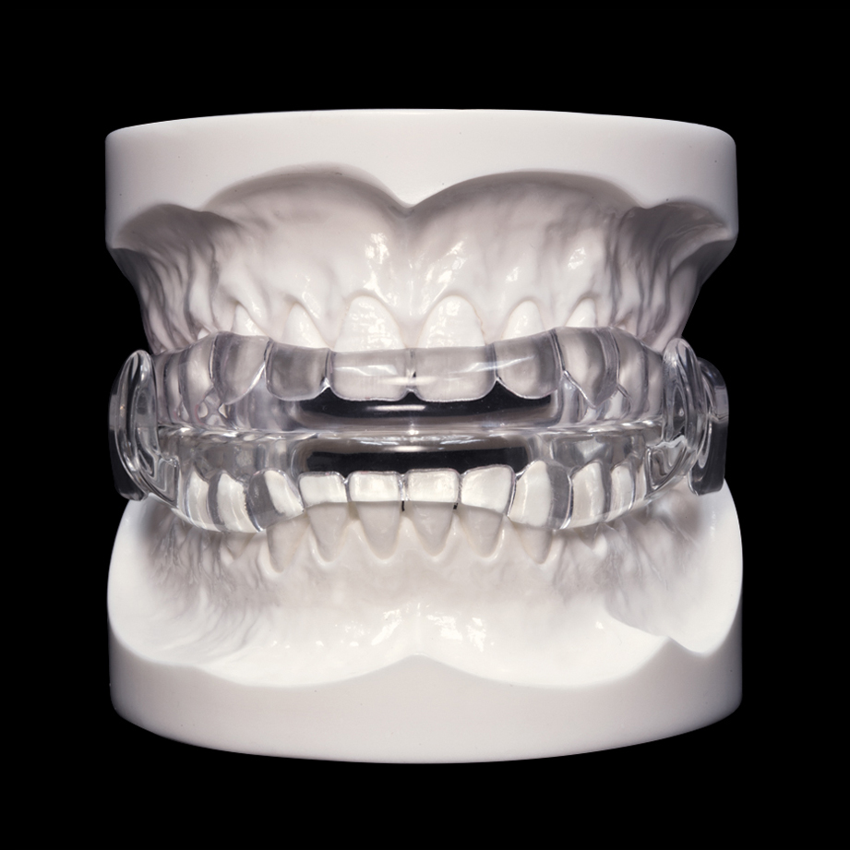
Oral AppLIances don’t WORK

Slide 24
Reasons not to Change
What we are doing is working!
There is a financial disincentive to change.
Inability to grasp the challenges and alternative treatments available.
Fear that the changes made will not be effective.
A mind set that prevents change in an industry or company.
Poor management!

Slide 25
Standard of Care For OSA in the US
Diagnosis of OSA
Placement on CPAP (fixed or Auto)
Trial of CPAP over weeks or months
If failure keep trying. If failure again keep trying….
Patient disappears and is lost to follow up

Slide 26
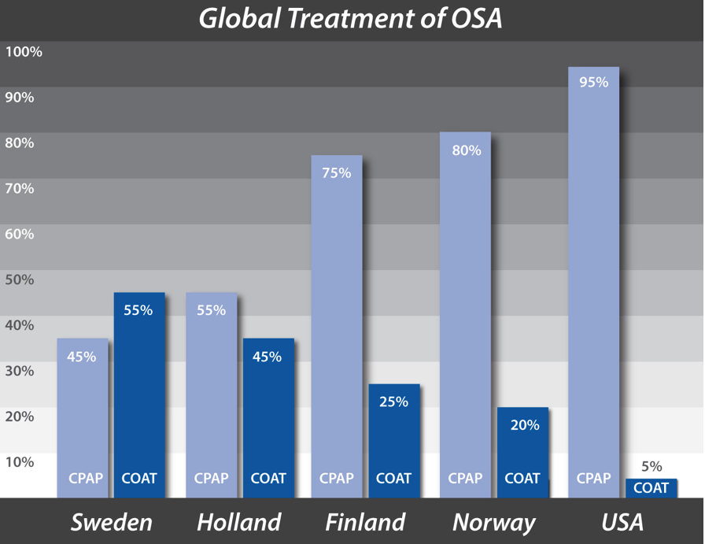
Global Trends
Notes:
The adoption of oral appliances show significant variability across different geographies. In Europe there is a substantially higher usage of Dental appliances. There are likely multiple factors that are at play. In the US CPAP is the main treatment despite large studies showing that compliance rates are in the 50-70 percent range and numerous studies showing that patients prefer treatment with an oral appliance.
Integration of CPAP services into physician practices, the lack of infrastructure to facilitate care coordination between physicians and dentists likely play pivotal roles.

Slide 27
AASM 2015: We recommend that sleep physicians consider prescription of oral appliances, rather than no treatment, for adult patients with obstructive sleep apnea who are intolerant of CPAP therapy or prefer alternate therapy. (STANDARD)
Common Guidelines
Oral appliances indicated for initial treatment for mild to moderate OSA
Oral appliances may be used for severe sleep apnea patients for those who are intolerant or refuse CPAP

Slide 28
Efficacy of OAT
 | Mild | Mod | Severe
Marklund (1998) | 81% | 60% | 25%
Parker (1999) | 100% | 78% | 0%
Pellanda (1999) | 100% | 86% | 40%
Pancer (1999) | 67% | 58% | 47%
Lowe (2000) | 87% | 47% | 45%
<5
AHI
<10
50% reduction
Notes:
^{6, 11, 12} Hoffstein V., Review of oral appliances for treatment of sleep-disordered breathing Sleep Breath. 2007 March; 11(1): 1–22
^{7, 8, 9, 10, 13} Ferguson K., Cartwright R., Rogers R., Schmidt-Nowara W, Oral Appliances for Snoring and Obstructive Sleep Apnea: A Review, SLEEP, Vol. 29, No. 2, 2006: 244-262
The Practice Parameters for the Treatment of Snoring and Obstructive Sleep Apnea with Oral Appliances: An Update for 2005 is also another resource. Kushida CA, Morgenthaler TI, Littner MR, Alessi CA, Bailey D, Coleman J Jr, Friedman L, Hirshkowitz M, Kapen S, Kramer M, Lee-Chiong T, Owens J, Pancer JP, Practice Parameters for the Treatment of Snoring and Obstructive Sleep Apnea with Oral Appliances: An Update for 2005 American Academy of Sleep Medicine. Sleep. 2006 Feb 1;29(2):240-3.

Slide 29
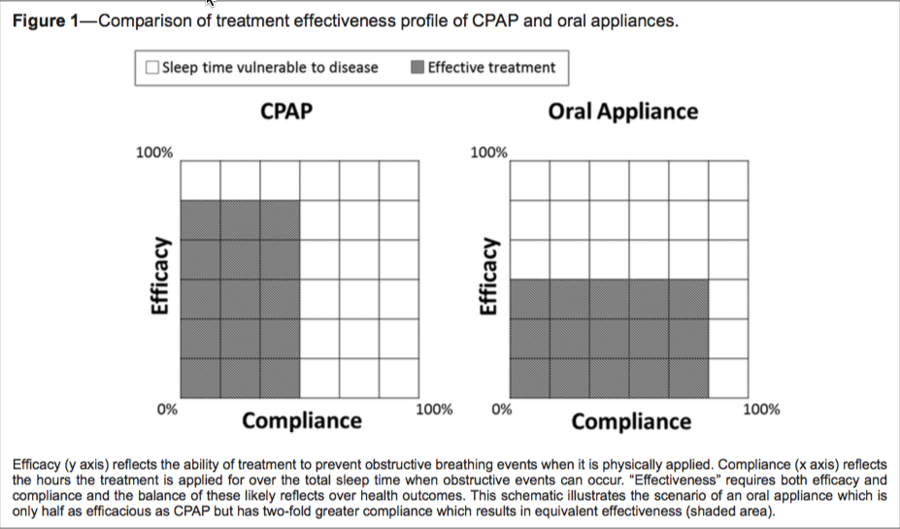
Efficacy versus Effectiveness
Efficacy: how something works in the ideal world
Effectiveness: how something works in the real world

Slide 30
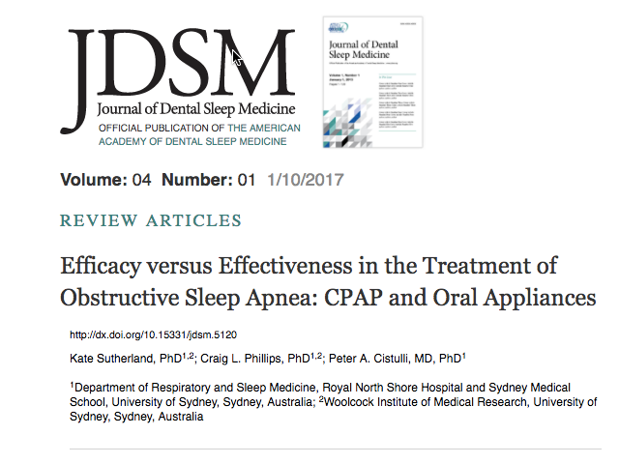
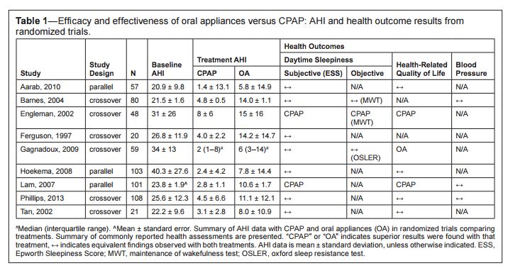

Slide 31
Physician Acceptance of Oral Appliances
“CPAP is the better treatment (Mean disease alleviation).”
“How do I know if the dentist is qualified to deliver an OA?”
“Efficacy studies often show residual events.”
“I would like to refer to that dentist but he/she won’t accept my patient’s insurance”.
“My patient has Medicare and the dentist does not have a DME license”.
“The dentist is not in-network and it is too expensive for my patients”.

Slide 32
What is the Problem?
Obstructive Sleep Apnea is a medical disorder and the majority of the patients could be treated with Oral Appliance Therapy.
Sleep physicians continue to preach that the “Gold Standard” in the treatment of OSA is CPAP.
In most states dentists cannot diagnose OSA or order a HST without being liable for practicing outside the scope of their license.
Dentists need referrals from Sleep Physicians and prescriptions for the oral appliances (Medicare and most insurance companies).

Slide 33
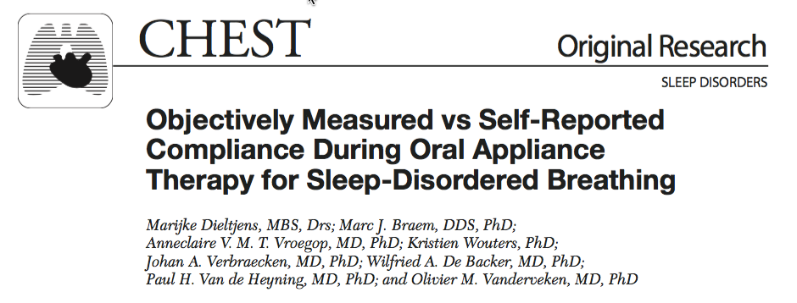
51 patient prospectively followed for 1 year
Regular use noted in 83% of patients
Average usage 6.4 +/- 1.7 hours/night
Difference between subjective and objective report: 30 minutes

Slide 34
Notes:
Importance Obstructive sleep apnea is associated with higher levels of blood pressure (BP), which can lead to increased cardiovascular risk.
Objective To compare the association of continuous positive airway pressure (CPAP), mandibular advancement devices (MADs), and inactive control groups (placebo or no treatment) with changes in systolic BP (SBP) and diastolic BP (DBP) in patients with obstructive sleep apnea.
Data Sources The databases of MEDLINE, EMBASE, and the Cochrane Library were searched up to the end of August 2015 and study bibliographies were reviewed.
Study Selection Randomized clinical trials comparing the effect of CPAP or MADs (vs each other or an inactive control) on BP in patients with obstructive sleep apnea were selected by consensus. Of 872 studies initially identified, 51 were selected for analysis.
Data Extraction and Synthesis Data were extracted by one reviewer and checked by another reviewer. A network meta-analysis using multivariate random-effects meta-regression was used to estimate pooled differences between each intervention. Meta-regression was used to assess the association between trial characteristics and the reported effects of CPAP vs inactive control.
Main Outcomes and Measures Absolute change in SBP and DBP from baseline to follow-up.
Results Of the 51 studies included in the analysis (4888 patients), 44 compared CPAP with an inactive control, 3 compared MADs with an inactive control, 1 compared CPAP with an MAD, and 3 compared CPAP, MADs, and an inactive control. Compared with an inactive control, CPAP was associated with a reduction in SBP of 2.5 mm Hg (95% CI, 1.5 to 3.5 mm Hg; P < .001) and in DBP of 2.0 mm Hg (95% CI, 1.3 to 2.7 mm Hg; P < .001). A 1-hour-per-night increase in mean CPAP use was associated with an additional reduction in SBP of 1.5 mm Hg (95% CI, 0.8 to 2.3 mm Hg; P < .001) and an additional reduction in DBP of 0.9 mm Hg (95% CI, 0.3 to 1.4 mm Hg; P = .001). Compared with an inactive control, MADs were associated with a reduction in SBP of 2.1 mm Hg (95% CI, 0.8 to 3.4 mm Hg; P = .002) and in DBP of 1.9 mm Hg (95% CI, 0.5 to 3.2 mm Hg; P = .008). There was no significant difference between CPAP and MADs in their association with change in SBP (−0.5 mm Hg [95% CI, −2.0 to 1.0 mm Hg]; P = .55) or in DBP (−0.2 mm Hg [95% CI, −1.6 to 1.3 mm Hg]; P = .82).
Conclusions and Relevance Among patients with obstructive sleep apnea, both CPAP and MADs were associated with reductions in BP. Network meta-analysis did not identify a statistically significant difference between the BP outcomes associated with these therapies

Slide 35
Summary of Results
In patients with the full spectrum of OSA severity:
BP Control with MAS was non-inferior to BP with CPAP (neither treatment improved BP overall)
Both treatments improved (by a similar amount)
arterial stiffness
sleepiness
driving simulator performance
QOL scores (MAS superior to CPAP – some mental QOL scores)
The results are likely explained by the greater efficacy of CPAP being offset by the superior compliance with MAD

Slide 36
Cardiovascular Mortality: CPAP Vs Oral Appliance
Anandam et Al: Respirology 2013
Evaluate long term cardiovascular mortality in patients with severe OSA treated with CPAP Vs OAT
Non concurrent Cohort study
570 patients with severe OSA and control group of 269 followed up for median of 79 months
All patients received CPAP initially. MAD offered to those who were non compliant
Results reported: 208 controls, 177 CPAP, 72 MAD

Slide 37
Results
Both treatments resulted in decreases in AHI and ESS (CPAP had greater effect)
Frequency of diastolic dipping higher in MAD group
Significant drop in catalase activity in MAD group
HRV decreased in both groups and was significant compared to baseline levels
Compliance was higher with MAD
Notes:
AHI baseline 42, sham: 48, OAT: 26 CPAP 11
O2 sat baseline 81, sham 78 OAT 84 CPAP 90
Compliance OAT 86% CPAP 72%

Slide 38
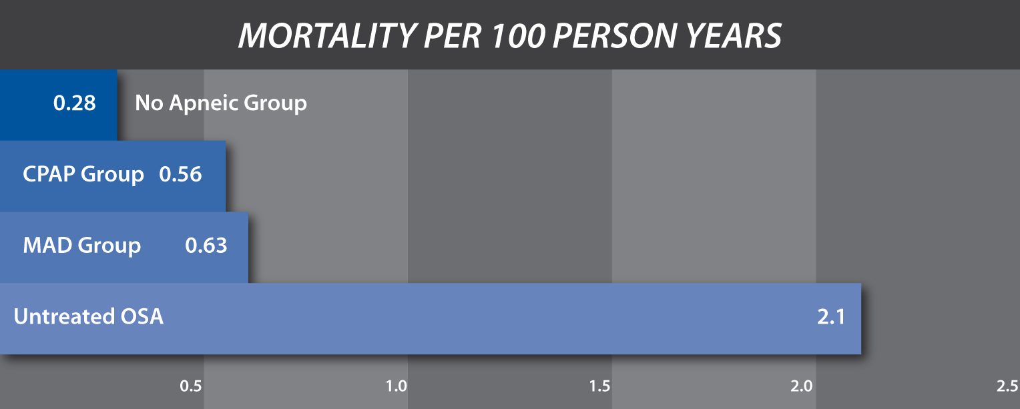
Conclusions: Mortality Rates
Both CPAP and MAD may be equally effective therapy in reducing risk of fatal cardiovascular events in patients with severe OSA

Slide 39
CHANGE is not EASY!

Slide 40
AASM & AADSM Protocols
Assessment by sleep physician
MD Provides written referral a copy of PSG
Dentist assesses patient for OA
Informed consent about risks and benefits
OA initiated and titration completed by dentist
Patient referred back to physician for medical assessment of OA’s therapy effectiveness
Follow-up PSG or HST
Additional titration or additional alternative treatment
Annual dental follow-up assessment; SRBD may worsen over time

Slide 41
AASM & AADSM Protocols
Care is complicated and burdensome
Treatment takes too long
Compliance with CPAP has not improved since 1981
Oral appliance therapy has been available since the 1980’s
Dentists are unable to diagnose OSA and order a HST in most states
Dentists must network with physicians for referrals

Slide 42
Effective AHI (Boyd, et al 2016)
It is important to distinguish between treatment efficacy and treatment effectiveness.
Effectiveness of treatment in the real world setting is a better measure of residual disease burden.
When PAP adherence is defined as > 4 hrs; 46% to 83% of pts with OSA have been reported to be non-adherent to treatment .
(WeaverTE, Grunstein RR 2008)

Slide 43
Effective AHI (Boyd et al 2016)
The observed low partial adherence rates may leave patients exposed to high apnea/hypopnea burden with attendant chronic intermittent hypoxia and sleep fragmentation when therapy is not being used.
Patients with severe OSA are at increased risk of fatal and non-fatal cardiovascular events when CPAP is not used.

Slide 44
PAP Therapy vs non-PAP Therapy
How can you compare a treatment that requires compliance for clinical effectiveness to one that does not?
There is no universally agreed-upon outcome metric for SDB to assess the comparative effectiveness of different OSA treatments.
Effective AHI: potential to overcome this comparative effectiveness problem as it measures the AHI during both the time therapy is and is not being used.
May provide clinician the tool to assess the treatment that provides the highest level of control of SDB (treatment-related changes in AHI)

Slide 45
Effective AHI: The New Gold Standard
May facilitate determination of the comparative effectiveness of different therapies, with the goal of selecting the most effective therapy for an individual patient.
It is important to measure the Effective AHI in the real-world home setting and the Watch PAT has been validated the accuracy of a PM which can be used to measure the Effective AHI for any OSA therapy in the home setting on single or multiple nights without significantly disturbing sleep (Boyd et al 2016)

Slide 46
Effective AHI (Boyd et al 2016)
Effective AHI: equals the sum of the apneas and hypopneas during the time the patient is using PAP (PAP On) and is not using PAP (PAP Off) divided by the total sleep time.
It is not known if 4 hours or more of nightly PAP use provides adequate control of severe OSA, as measured by Effective AHI.
Effective AHI: more accurately quantifies the residual disease burden.

Slide 47
Effective AHI (Boyd et al 2016)
PAP therapy resulted in significant reduction in the AHI (mean reduction 73%)
SDB is essentially eliminated during the time PAP is being used.
When PAP was used >6 hours the effective AHI was consistently normalized (100% of patients with AHI <5)
PAP use < 6hrs: Effective AHI scores were normalized only in those patients who slept exclusively in non-supine position when PAP was not being used.

Slide 48
Effective AHI (Boyd et al 2016)
Overall, 63.6% of the patients using CPAP <6 hours still had moderate to severe OSA (Effective AHI > 15)
Weaver et al (2008) : greatest gains in the number of patients reaching normal values for subjective sleepiness (ESS), objectively measured sleepiness (MSLT) and disease specific quality of life (Functional Outcomes of Sleepiness Questionnaire) required 4, 6, and 7.5 hours of nightly CPAP use, respectively.

Slide 49
CPAP Usage: Optimal Time?
Zimmerman, et al (2006): > 6 hours of CPAP use optimizes normalization of memory performance
Campus-Rodriguez et al (2005): > 6 hours of CPAP use provides the greatest mortality risk reduction
Barbe et al (2010): improvements in blood pressure was only evident in OSA patients who used CPAP more than 5.6 hours per night

Slide 50
CPAP: The Bottom Line
The evidence strongly indicates that the cut off point for defining optimal adherence to PAP therapy for patients with severe OSA should be 6 hours or more of nightly PAP use (entire sleep period)
Using CPAP the entire night, every night, is the level of use where the largest number of patients will likely reach near normal levels of several important outcome measures
Defining compliance with CPAP as 4-5 hours a night in 7/10 days is inconsistent with current research and should be changed!!!

Slide 51
Effective AHI: A New Gold Standard
Assesses the true effectiveness of OSA therapy, as it directly measures treatment-related changes in the AHI.
Could be applied more broadly for assessment of any OSA therapeutic intervention including both compliance-based (PAP and OAT) and non-compliance based therapy (surgery).

Slide 52
CPAP vs Oral Appliance Therapy
Despite nearly 100% efficacy of CPAP it is clear its effectiveness is compromised by poor compliance.
Effective AHI accounts for the time the CPAP is used and further weakens the effectiveness of CPAP in the treatment of OSA.
Current research supports that when CPAP usage is < 6 hrs health outcomes such as sleepiness, health related quality of life, and cardiovascular events are further compromised.
Physicians need to understand the weaknesses of CPAP and embrace OAT!!!

Slide 53
Combination Therapy (CPAP and OAT)
Retrospective study : 14 male patients with severe OSA
Initial tx: 2 weeks of PAP: if intolerant of high pressure (>15 cm H20)
Switched to 12 weeks of MAD (monobloc at 75% maximum protrusion)
High residual AHI (>15/hr) 12 weeks of combination therapy
All 3 treatments reduced AHI, ODI, and TST <90%
Residual AHI and ODI on CT was lower than that on MAD or PAP
Therapeutic pressure was reduced on CT an average of 9.2 lower than that on PAP (Liu et al 2017)

Slide 54
Combination Therapy (CPAP and OAT)
10 patients with residual apnea/hypopnea events on MAD
After 1 week washout period off MAD, used an auto-CPAP unit with MAD for 3 nights
Combination of MAD and nasal CPAP was well tolerated
Optimal pressure on CT reduced from 9.4 to 7.3 (p= .001)
Residual AHI reduced from 11.2 to 3.4 (p<.001)
( El-Solh AA, et al Sleep Breath 2011)

Slide 55
Sleep Adjusted Residual AHI (SARAH INDEX)
Evidence of equivalent health outcomes between OA’s and CPAP suggest that real-world treatment effectiveness is not captured by just the efficacy of the treatment.
The different treatment profiles of CPAP (high efficacy/low adherence) and oral appliances (moderate efficacy/high adherence) may conceptually result in similar profiles of treatment effectiveness.

Slide 56
Sleep Adjusted Residual AHI (SARAH INDEX)
Treatment effectiveness is a composite of efficacy and the hours of treatment usage.
As an example, MAS may be only ½ as efficacious as CPAP, but compliance is two-fold greater.
Despite these different treatment profiles, both treatments have similar overall effectiveness in relieving OSA.
This reflects many patients in the real world!!

Slide 57
Sleep Adjusted Residual AHI (SARAH INDEX)
A more representative measure of treatment effectiveness than AHI (treatment) should also take into account hours ON treatment (AHI Treatment) and hours OFF treatment (AHI Untreated) for the TOTAL sleep period.
This index accounts for these additional factors in order to assess a more accurate measure of treatment effectiveness which has been called the Sleep Adjusted Residual AHI or SARAH INDEX.

Slide 58
Sleep Adjusted Residual AHI (SARAH INDEX)
Sleep Adjusted Residual AHI (SARAH INDEX) =
(AHI treatment x hrs treatment) + (AHI untreated x hrs untreated)
divided by Hours of Total Sleep Time
Since this index incorporates currently overlooked factors it could be a more accurate measure of treatment effectiveness and will better align with downstream health benefits.

Slide 59
AHI and SARAH INDEX: CPAP vs MAS
Oral Appliances were non-inferior to CPAP across a range of health outcomes in predominately moderate-severe patients.
No between-treatment differences in cardiovascular (24-h BP, arterial stiffness), neurobehavioral (subjective sleepiness, driving stimulator performance), or quality of life outcomes.
Efficacy and compliance profiles of CPAP and oral appliance therapy suggest that superior CPAP efficacy may be offset by greater oral appliance usage.
Phillips et al (2013)

Slide 60
Strategy for Oral Appliance Acceptance
Medical education via conferences & seminars
OSA education in dental schools
Screening initiative in all dental offices
Screening in primary care offices
Efficacy studies and guided research
Direct to consumer marketing to increase awareness of OSA
Partnerships to increase awareness of OSA, drive sales and scale growth

Slide 61
Strategy for Physician Acceptance of OAT
Side effects are minimal and may be managed with little difficulty
Dentists will provide the oral appliance upon referral of the sleep physician
After titrating the appliance, the dentist refers the patient back to the physician for efficacy studies
ProSomnus establishes a network of qualified dentists

Slide 62
Strategy for Physician Acceptance of OAT
Education about “mean disease alleviation”
Effectiveness is a reflection of compliance and not just efficacy
Education about Effective AHI
Efficacy studies on patients with OAT for OSA at all level of severity
Emphasis on the strength of combination therapy
Patient preference improves compliance!

Slide 63
OAT Awareness and Perceptions Survey
Online Survey between 12/2/15 and 12/29/15.
Targeted sleep medicine professionals:
64% Sleep center director, supervisor, or manager
23% Sleep Medicine physician
4% Pulmonologist
4% Neurologist
2% Otolaryngologist
(Sleep Review 2016)

Slide 64
OAT Awareness and Perceptions Survey
Goal: insights into what physicians and sleep directors think about OAT and what the considerations are when determining whether to refer an OSA patient to a dentist.
10 questions in length, developed by the editorial staff in conjunction with several editorial advisory board members.
Survey is considered to provide preliminary results that provide a general overview only.
Plan to conduct more focused surveys to more accurately predict practice behavior and redefine the questions.

Slide 65
Top Reasons to Not Refer for OAT
“I want to try other strategies to get the patient CPAP adherent.”
”The patient won’t be able to afford an appliance.”
“The oral appliance may not be efficacious.”
“The oral appliance won’t record the patient’s adherence with the therapy.”
(Sleep Review 2016)

Slide 66
Top Reasons to Not Refer for OAT
“The patient may develop side effects from using the oral appliance.”
“I worry dentists are acting outside the scope of practice in all or in part when treating OSA.”
“Patients ‘disappear’ when I refer them to a dentist.”
“I don’t know a local dentist who I trust with my patients.”
(Sleep Review 2016)

Slide 67
Complications from CPAP
Mask interface problems
Claustrophobia
Vasomotor rhinitis
Transient insomnia
Dry mouth
Aerophagia
Central or complex sleep apnea

Slide 68
Mask Interface Problems
Skin irritation
Skin breakdown
Change in dentitions
Mask discomfort

Slide 69
Conclusions : Physician Acceptance
Efficacy studies are critical to physician acceptance!!
Patient comfort and compliance are marketing points!!
Open discussions of side effects of OAT.
Insurance coverage is essential to service large numbers of patients.
The introduction of the (PH) product will allow ProSomnus customers to treat their Medicare patients.
Combination therapy improves outcomes.

Slide 70
Conclusions: Physician Acceptance
Embrace all the concerns that physicians have about OAT and use them as a guide to further acceptance!!
As more oral appliances are delivered, sleep physicians will generate more efficacy testing in their labs (with either PSG or HST).
Consider the Telemedicine approach as a viable alternative treatment paradigm which ultimately will drive business to the sleep physicians.
Emphasize the choice and efficacy of OAT in mild to moderate OSA patients as it is consistent with the guidelines of the AASM.

Slide 71
CPAP: the Gold “Plated” Standard
Its time to change the so called label as the standard of care in the treatment of OSA.
OAT is not a new treatment for OSA.
The AASM guidelines recommend Oral Appliances in the treatment of patients with mild to moderate OSA as first line therapy in patients that prefer this treatment over CPAP.
Patients with severe OSA should have a trial of CPAP before treatment with OA’s (AASM guidelines).

Slide 72
Efficacy of ProSomnus {IA}
39 year old ER Physician at Upstate Medical Center
Works day and night shifts; complains of hypersomnolence
Fitted with ProSomnus {IA} titrated to U2/LO
AHI reduced from 21.1/hr-2/hr
O2 Sat Nadir increased from 81%-91%
Hypersomnolence persists, started on Provigil 200mg qd
Will obtain PSG/MSLT to rule out Narcolepsy if necessary

Slide 73
Efficacy of ProSomnus {IA}
53 year old woman, unable to tolerate CPAP
HST 12/29/16 AHI 42.9/hr O2 Nadir 83%
Treated with ProSomnus {IA} titrated to U2/L1
HST 5/3/18 AHI 3/hr O2 Nadir 87%
BP under better control!

Slide 74
Efficacy of ProSomnus {IA}
34 year old social worker
PSG 2/25/08 AHI 26.7/hr O2 Nadir 86%
Had another appliance in the past, now with ProSomnus {IA} appliance titrated to U0/L1
HST 4/25/18 AHI 0/hr O2 Nadir 92%

Slide 75
Efficacy of ProSomnus {IA}
56 year old woman who could not tolerate CPAP
PSG 11/28/11 AHI 99/hr O2 Nadir 85%
Fitted with ProSomnus {IA} titrated to U2/L1
HST 3/20/18 AHI 2/hr, RDI 8/hr O2 Nadir 88%
Ordered U4 to try and improve oxygenation, results pending

Slide 76
Efficacy of ProSomnus {IA}
57 year old woman who could not tolerate CPAP
PSG 2/15/12 AHI 25.6/hr O2 Nadir 83%
Fitted with ProSomnus {IA } C series titrated to U1.5/L1
HST 5/8/18 AHI 4/hr O2 Nadir 86%

Slide 77
Conclusions:
Effective AHI is the best means for evaluating different treatment modalities.
Efficacy is an ideal world parameter where as effectiveness is the real world parameter and metric of success.
Effectiveness accounts for the differences in compliance of Oral Appliance Therapy vs CPAP Therapy.
When considering Mean Disease Alleviation, the SARAH Index and Effective AHI, Oral Appliance Therapy may be a better treatment solution than CPAP for most patients with OSA.

Slide 78
CHANGE is not EASY!

